Slide 1


Python – List & Tuples
M M Mahbubul syeed, phd. Associate professor

Slide 2
Highlight
Tuples – what is it!!??
Why we use tuples?!.
Construction (memory and index) of a tuple.
Tuple operations (basic).
Tuple operations (build in functions).
Tuple operations (tuple functions).

Slide 3
Tuple
tup1 = (1, 2, 3, 4, 5)
tup1
1 | 2 | 3 | 4 | 5

Slide 4
Tuple – What is it?!
A tuple is a sequence of immutable (that cannot be changed) Python objects.
Tuples are sequences, just like lists.
The main difference between the tuples and the lists is that
the tuples cannot be changed
unlike lists. Tuples use parentheses, whereas lists use square brackets.
Example:
tup1 = ('physics', 'chemistry', 1997)
tup2 = (1, 2, 3, 4, 5 )
tup3 = "a", "b", "c", "d"
Memory
tup2
1 | 2 | 3 | 4 | 5

Slide 5
Tuple – Declare
Output
tup1 = ('physics', 'chemistry', 1997, 2000)
tup2 = (1, 2, 3, 4, 5 )
tup3 = "a", "b", "c", "d"
print(tup1)
print(tup2)
print(tup3)
('physics', 'chemistry', 1997, 2000)
(1, 2, 3, 4, 5)
('a', 'b', 'c', 'd')
The empty tuple is written as two parentheses containing nothing.
tup_empty = ()
print("Empty tuple: ", tup_empty)
tup4 = (50,)
print(tup4)
Empty tuple: ()
(50,)
To write a tuple containing a single value you must include a comma, even though there is only one value.

Slide 6
Tuple – Indexing
index or indices
Tuple indices start at 0 (Left to right).
Tuple indices start at -1 (right to left).
Memory
Memory Location
Left to right
0 | 1 | 2 | 3 | 4
tup1 = (1, 2, 3, 4, 5,6)
print(tup1)
print(tup1[1])
print(tup1[1:3])
print(tup1[2:])
print(tup1[-2])
print(tup1[-3:])
print(tup1[-4:-1])
print(tup1[-4:])
tup1
1 | 2 | 3 | 4 | 5
-5 | -4 | -3 | -2 | -1
Output
Memory Location
Right to left
(1, 2, 3, 4, 5, 6)
2
(2, 3)
(3, 4, 5, 6)
5
(4, 5, 6)
(3, 4, 5)
(3, 4, 5, 6)

Slide 7
Tuple – Why?
To store ordered list of items that requires no change, e.g., employee id, name, gender.
To carry out different useful operations on the list, e.g., sorting the marks, find min/max marks or price
Immutable data, meaning accidental change / modification are not possible, e.g., coordinates of a location.
Tuples are stored in a single block of memory.
Tuples are immutable so; It doesn't require extra space to store new objects.
It is the reason creating a tuple is faster than List.
It also explains the slight difference in indexing speed is faster than lists, because in tuples for indexing it follows fewer pointers.

Slide 8
Tuple – Update
Tuples are immutable, which means you cannot update or change the values of tuple elements.
You can take portions of the existing tuples to create new tuples.
Output
tup1 = (12, 34.56)
tup2 = ('abc', 'xyz')
# let's create a new tuple as follows
tup3 = tup1 + tup2
print (tup3)
# Following action is not valid for tuples
tup1[0] = 100
(12, 34.56, 'abc', 'xyz’)
Traceback (most recent call last):
File "c:\Users\M SYEED\OneDrive - American International University-Bangladesh\Desktop\Lab19\tuple.py", line 11, in <module>
tup1[0] = 100
TypeError: 'tuple' object does not support item assignment

Slide 9
Tuple – Delete
Use the del statement if you know exactly which element(s) you are deleting.
Output???
tup1 = (12, 34.56)
tup2 = ('abc', 'xyz')
# delete entire tuple is allowed
del(tup2)
# delete single item is not allowed
del(tup1[0])
print('After deleting..')
print(tup1)
Traceback (most recent call last):
File "c:\Users\M SYEED\OneDrive - American International University-Bangladesh\Desktop\Lab19\tuple.py", line 8, in <module>
del(tup1[0])
TypeError: 'tuple' object doesn't support item deletion

Slide 10
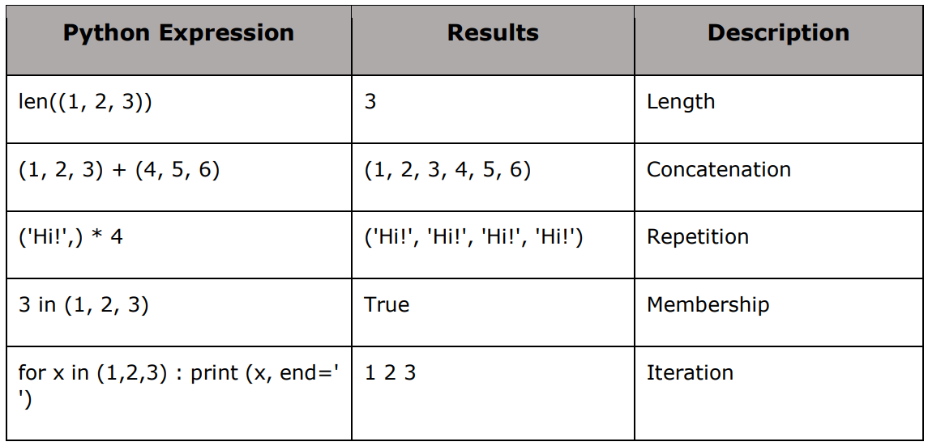
Tuple – Basic Operations

Slide 11
Tuple – Basic Operations
tup = ('physics', 'chemistry', 1997, 2000, 'Raining!', 1976)
print ('Total items in tuple: ', len(tup))
intuple = 'chemistry' in tup
print('is chemistry in the tuple: ', intuple)
for item in tup:
print(item, end =' ')
print(‘\n tup id: ', id(tup))
tup2 = (1,2)
tup = tup + tup2
print(tup)
print('tup id: ', id(tup))
print('tup2 id: ', id(tup2))
tup2 = tup2*3
print(tup2)
print('list2 id: ', id(tup2))
Output???
Total items in tuple: 6
is chemistry in the tuple: True
physics chemistry 1997 2000 Raining! 1976
tup id: 2414962255968
('physics', 'chemistry', 1997, 2000, 'Raining!', 1976, 1, 2)
tup id: 2414962623424
tup2 id: 2414962615616
(1, 2, 1, 2, 1, 2)
list2 id: 2414962257312

Slide 12
Built in Functions

Slide 13
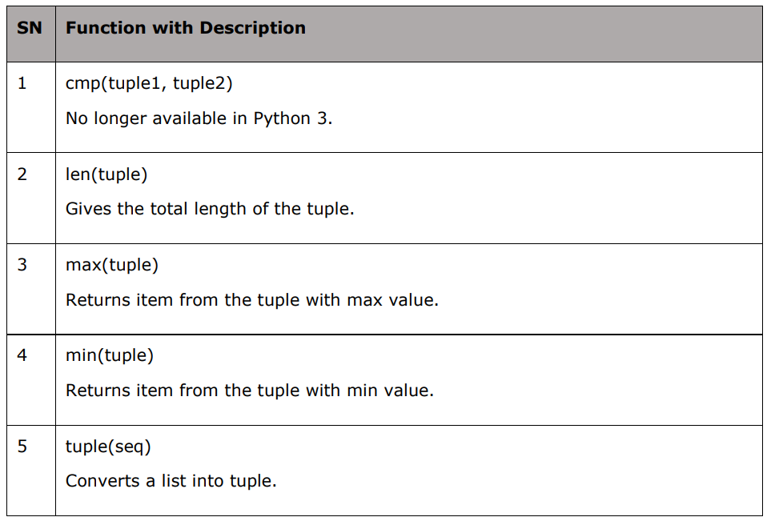
Tuple – Built in function

Slide 14
Tuple – Built in function
tup1, tup2 = ('C++','Java', 'Python'), (456, 700, 200)
print ('Total items in list: ', len(tup1))
print ("Max value element : ", max(tup1))
print ("Max value element : ", max(tup2))
print ("Min value element : ", min(tup1))
print ("Min value element : ", min(tup2))
aList = [123, 'C++', 'Java', 'Python']
print("Before conversion: ", aList)
convertedToTuple = tuple(aList)
print ("After conversion: ", convertedToTuple)
str="Hello World"
print("Before conversion: ", str)
strToTuple=tuple(str)
print ("After Conversion : ", strToTuple)
Output???
Total items in list: 3
Max value element : Python
Max value element : 700
Min value element : C++
Min value element : 200
Before conversion: [123, 'C++', 'Java', 'Python']
After conversion: (123, 'C++', 'Java', 'Python')
Before conversion: Hello World
After Conversion : ('H', 'e', 'l', 'l', 'o', ' ', 'W', 'o', 'r', 'l', 'd')

Slide 15
Tuple
Exercise

Slide 16
Check Your understanding
Output???
tup = ('apple', 75, 4.89, 'Abdullah', 'Dhaka')
tuple1 =tuple()
tuple1 = tup
print('tup: ', tup)
print('tuple1: ', tuple1)
print('id of tup: ', id(tup), '\nId of tuple1: ',id(tuple1))
tup2 = (5, 6, 'hello')
tup = tup + tup2
print('id of tup: ', id(tup), '\nId of tuple1: ',id(tuple1))
tuple1[1] = 'pineapple'
print('tuple1: ', tuple1)

Slide 17
tup = ('physics', 2001, 'chemistry', 1997, 'Rainy day!', 1976)
print (len(tup))
intuple = 'programming' in tup
print('Is programming in the tuple: ', intuple)
for item in tup:
print(item, end =' ‘)
print(tup)
tup2 = (1,2)
tup = tup + tup2
print(tup)
tup2 = tup2*3
print(tup2)
tup_merged = tup[-4:] + tup2[3:5]
print(tup_merged)
print(tup_merged[2:5])

Slide 18
Write a Python program to accomplish the followings:
Create a tuple with name numbers and insert 10 numbers in it.
Create a tuple with name cities and insert 5 name of the cities.
Create a tuple with name mixed and insert following values: apple, 75, 4.89, Abdullah, Dhaka
Now print values from all the tuples.
Find the minimum, maximum and avg from the tuple numbers, and print them.
Get the summation of the numbers from tuple mixed and print the summation result.
Change the value “apple” in mixed tuple to “orange”.
Merge the two tuples' numbers and cities together and print values of the new list.
How many items are there in the new tuple? Show the total number of items.

